Slide 1

Road Networks: Graphs and Their Types
Road networks are the backbones of transportation systems, enabling the efficient movement of people and goods. Understanding how to model these complex networks using graph theory is crucial for urban planning, traffic management, and infrastructure development.

Slide 2

What are Road Networks and Why Model Them?
Understanding Traffic Patterns
Infrastructure Planning
Graph-based models can guide the strategic placement of roads, bridges, and other transportation infrastructure.
Modeling road networks as graphs allows us to analyze traffic flow, identify bottlenecks, and optimize routing.
Emergency Response
Logistics Optimization
Graph-based road networks can help emergency services quickly navigate and respond to incidents.
Modeling road networks as graphs enables efficient route planning for delivery and distribution services.

Slide 3
Representing Road Networks Using Graphs
Nodes
Edges
Weights
In a road network graph, nodes represent intersections, junctions, or key locations.
Edges in the graph represent the roads or streets connecting the nodes.
Edges can be weighted to represent factors like distance, travel time, or traffic volume.

Slide 4

Undirected Graphs for Two-Way Roads
1
Bidirectional Connections
In an undirected graph, edges represent two-way roads where traffic can flow in both directions.
2
Symmetrical Weights
The weights on the edges are typically symmetrical, as the time or distance to travel in either direction is the same.
3
Simplified Modeling
Undirected graphs provide a more straightforward representation of road networks with two-way streets.

Slide 5
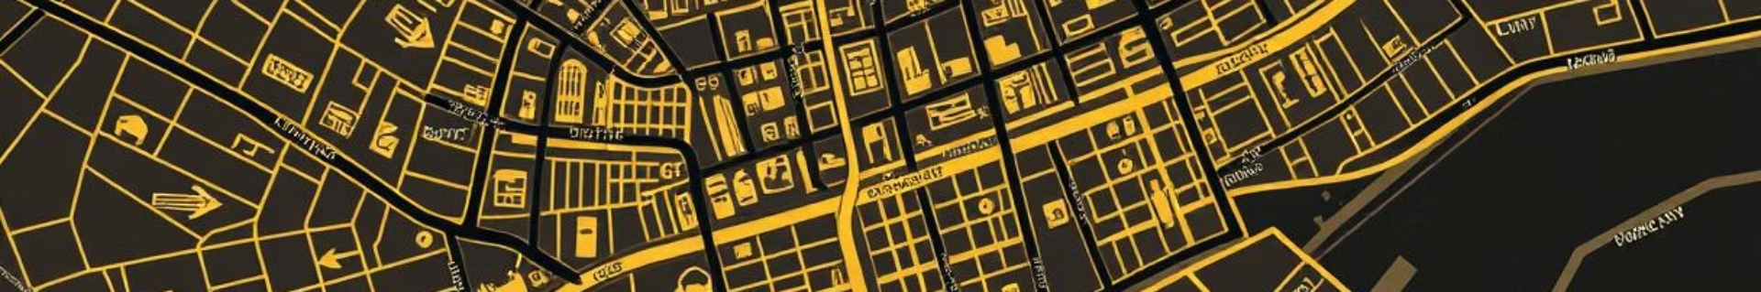
Directed Graphs for One-Way Roads
Unidirectional Edges
Accurate Modeling
Directed graphs use edges with arrows to represent one-way roads where traffic can only flow in a single direction.
Directed graphs provide a more realistic representation of road networks with one-way streets and turn restrictions.
1
2
3
Asymmetrical Weights
Edge weights in a directed graph can be different for each direction, reflecting the varying travel times or distances.

Slide 6
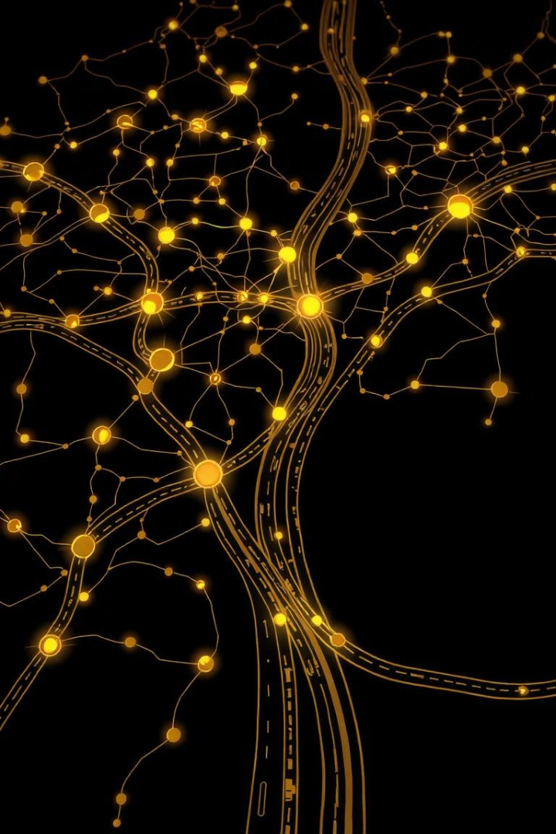



Real-World Applications of Road Network Graphs
Traffic Management
Analyzing road network graphs can help optimize traffic signals, identify congestion hotspots, and improve overall mobility.
Urban Planning
Graph-based models aid in the design and development of new roads, highways, and transportation infrastructure.
Logistics
Road network graphs enable efficient route planning and optimization for delivery services, supply chains, and emergency response.

